Slide 1
ANIMATED INTRO FOR SOCIAL MEDIA PLATFORMS
Here is where your presentation begins

Slide 2
Presented by : Rawan Emad
Least Common Multiple: Using Problem Reduction
Presented to : Doctor Islam El-shaarawy
ID:222517

Slide 3
Table of contents
01
03
02
The strategy
The problem
The algorithm
04
05
The analysis
The implementation

Slide 4
1)The problem: LcM
What is the LCM ?
-> The LCM is the smallest positive integer between two or more numbers that is divisible by each of the given integers without leaving any remainder.
Example: (10,6)
6= * 3 10= * 5 Therefore 2*3*5=30 (LCM)
2 | 10
5 | 5
 | 1
2 | 6
3 | 3
 | 1
2
2

Slide 5
2) The strategy
Solve LCM problem by using transform and conquer strategy specifically (problem reduction)
What is the problem reduction?
Problem reduction is a concept in computer science and mathematics that involves
transforming one problem into another problem in a way that preserves the solutions.
The idea is to show that if you can solve the second problem efficiently,
then you can also solve the first problem efficiently.
As an example of using problem reduction is solving Minimum problem by using the maximum problem

Slide 6
3)The algorithm
To solve lcm using problem reducion you have to know the GCD algorithm to solve from it the lcm
To get the gdc algorithm you have to know what is the gcd primarily
What is the GCD?
The GCD stands for "Greatest Common Divisor." It is the largest positive integer that divides two or more integers without leaving a remainder. In other words, it is the greatest number that can evenly divide the given numbers.

Slide 7
Example for GCD
(36,48)
12
36: 2,3,4,6,9, ,18
48: 2,3,4,6,8, ,16,24
we will see the greatest common factor
between the two integers which is (12)
36 | / | 2 | = | 18
36 | / | 3 | = | 12
36 | / | 4 | = | 9
36 | / | 5 | = | --
36 | / | 6 | = | 6
48 | / | 2 | = | 24
48 | / | 3 | = | 16
48 | / | 4 | = | 12
48 | / | 5 | = | ---
48 | / | 6 | = | 8
12

Slide 8
4)The implementation
GCD implementation
Two inputs ( positive, and not both=0)
The base case is b==0
then return a
Else return (b, a mod b)
GCD(a,b)= GCD(b,a mod b)
Therefore GCD of two numbers is equal to GCD of the small no and the remainder of the large no divided by the smaller one
(ecludian rule)

Slide 9



Triangle rule for lcm
Example: (24,18)
1st get the remainder of the two integers which is 6
2nd subistitute in the rule
LCM(m.n)=m*n/GCD(m,n)
6*?=24*18
Therefore LCM=72

Slide 10
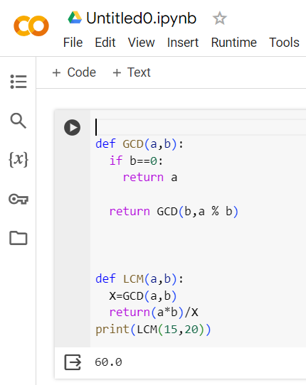
Lcm implementation
Inputs (a , b)
Variable receives gcd (a , b)
Return (a*b)/ variable

Slide 11
Thanks!
Do you have any questions?
addyouremail@freepik.com
+91 620 421 838
yourwebsite.com
Please keep this slide for attribution

Slide 12
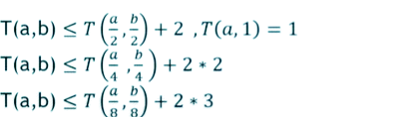
5)The analysis
To make the analysis we will assume that a>b
Therefore (a mod b < a/2)
We will also assume that in the worst case a & b both are halfed
T(a , b)<= T(a/2,b/2)+2
*Then we substitute 8 by 2^3 to get pattern
*Then we substitute 3 by K

Slide 13

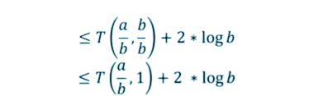

Then to reach the base case we will subsitute every k by logb
Rule: 2^log num= num
Replace the first part by our base case

Slide 14
Thank you

